Slide 1
DXC – Realtime Project
Name: Thopucherla Sujith
Reg No: DXC262AB1210

Slide 2
Contents :
Project1 : Smart Vehicles
Project2 : AP Morgan Data Platform

Slide 3
Project-1: Smart Vehicles
Task: Transfering data from Storage account to Sql database.
Steps involved :
Creating a storage Account.
Creating a SQL Database.
Creating Data factories.
Creating Pipeline to copy data.

Slide 4
Step-1: Creating a storage Account.
Search for Storage Account in Menu bar and click on create a new storage account .
After creating Storage account , Create a Container to store data .

Slide 5
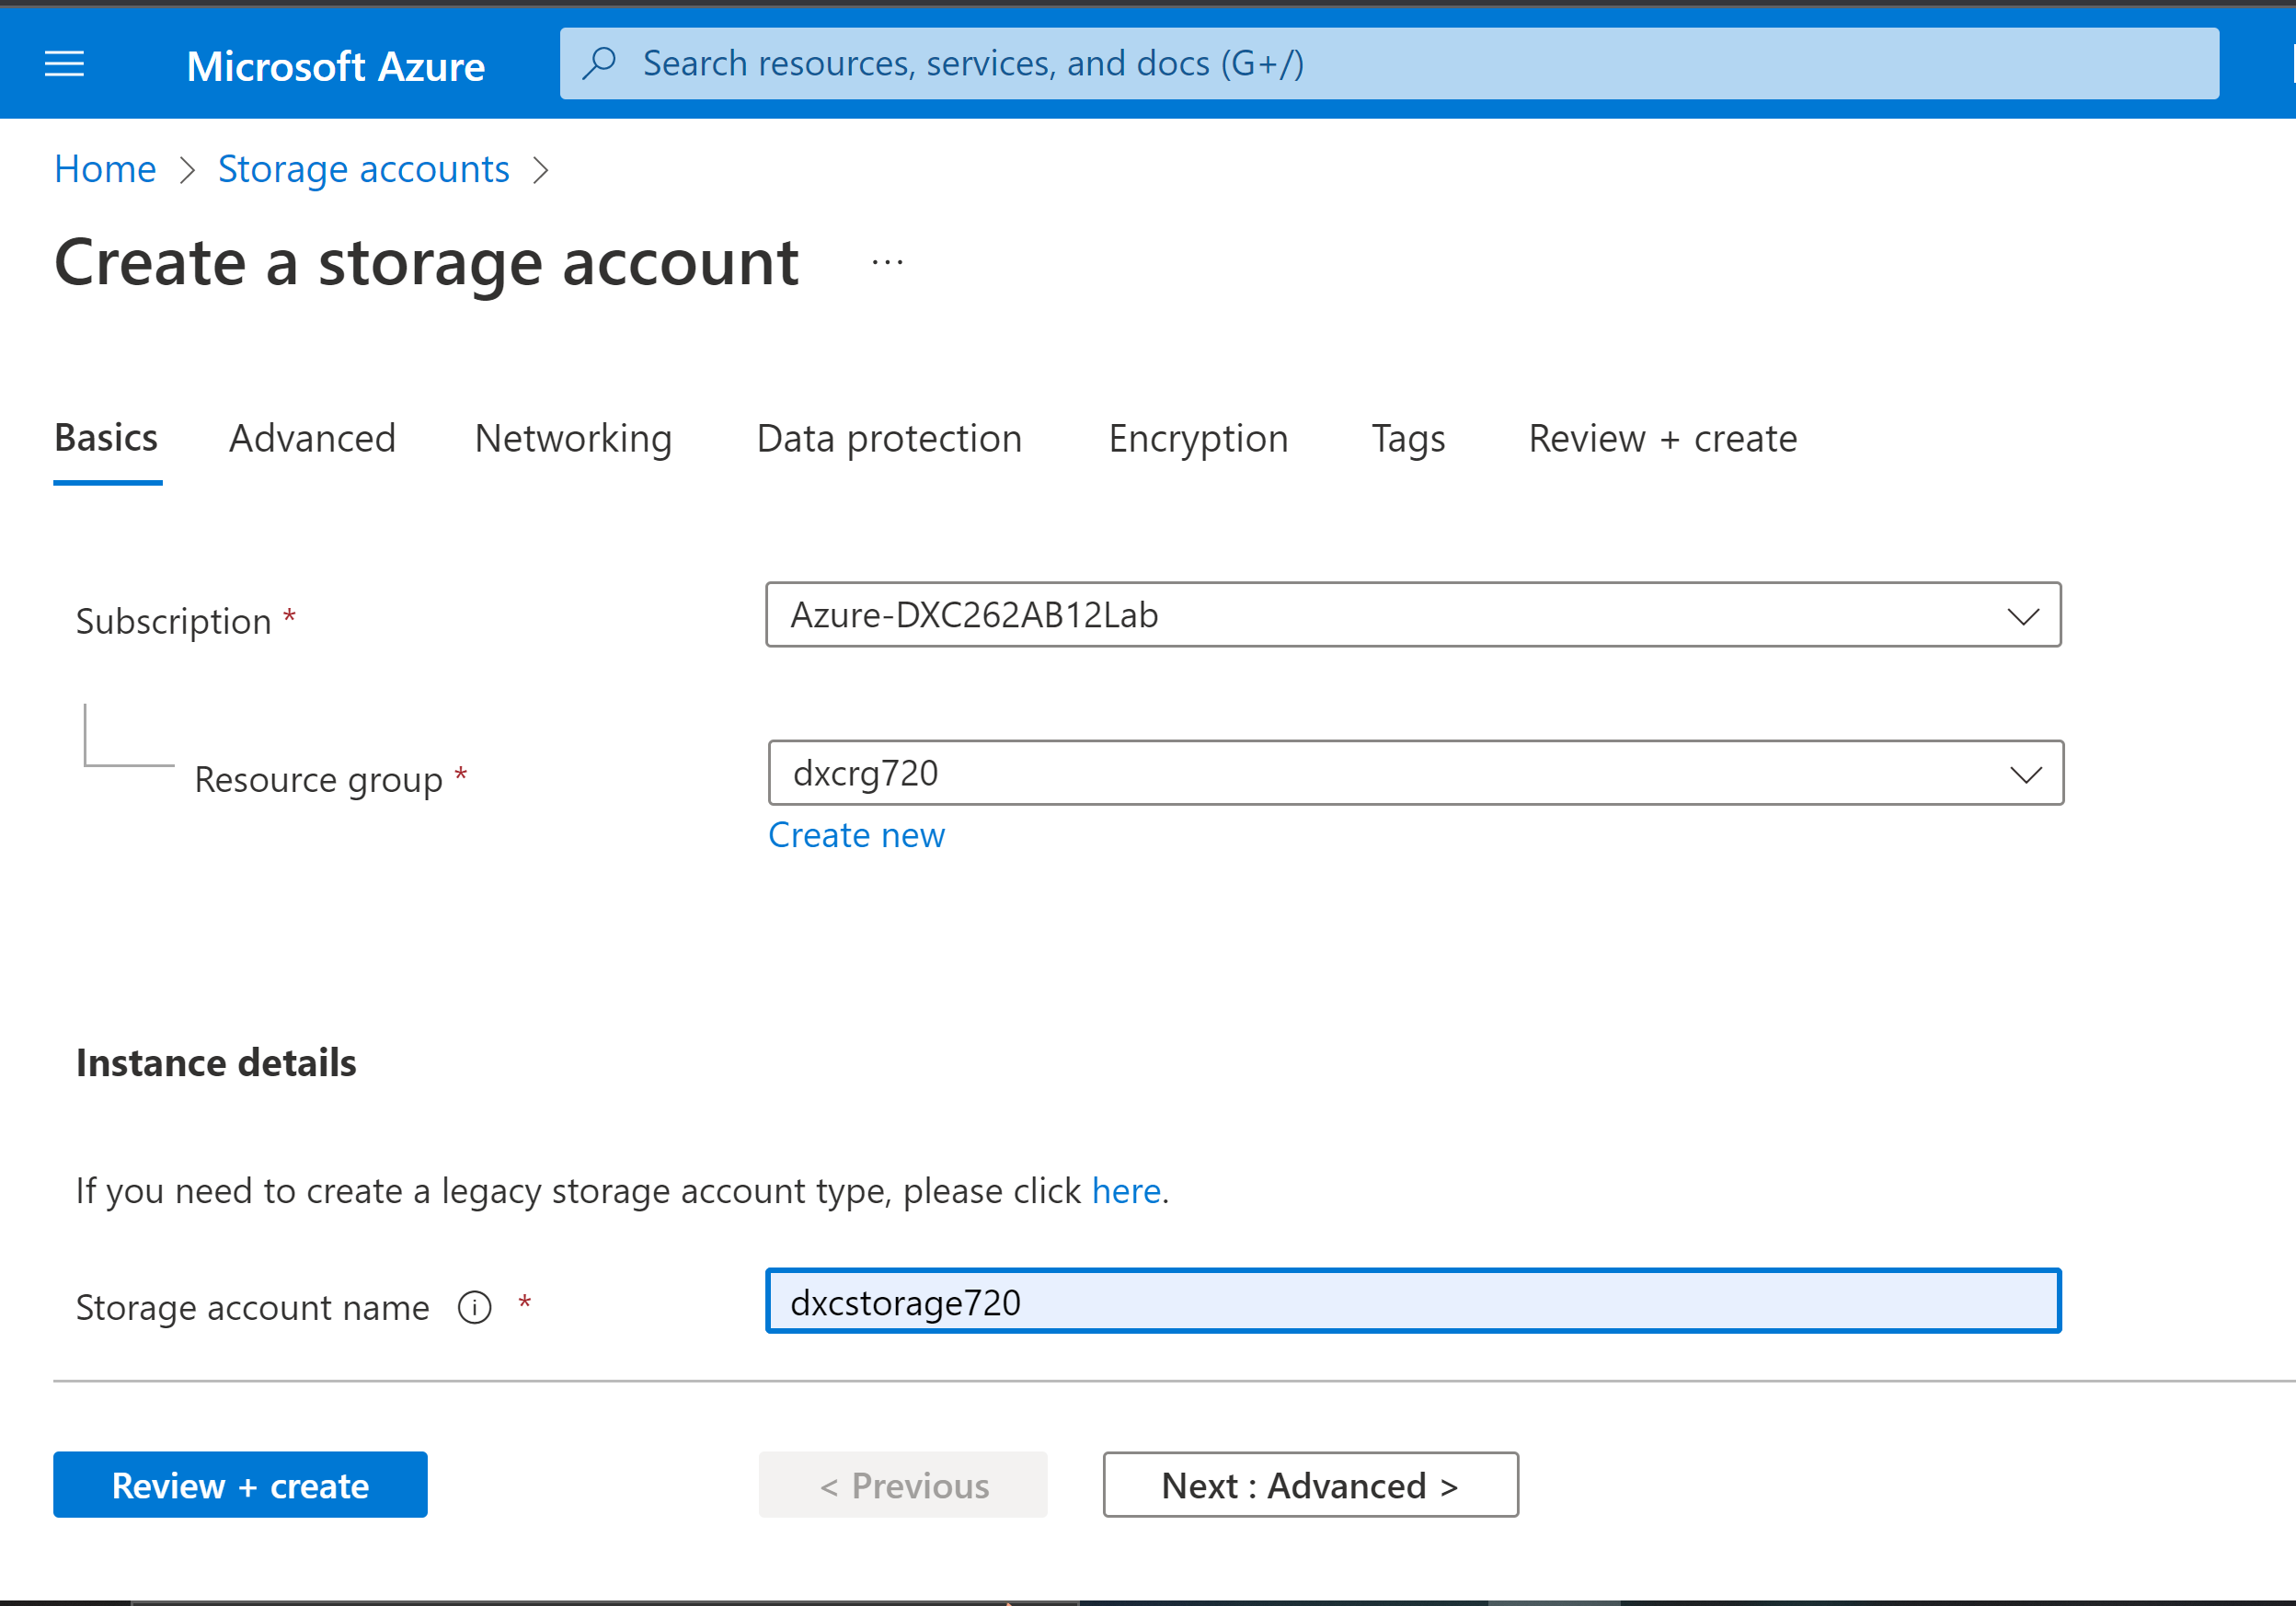
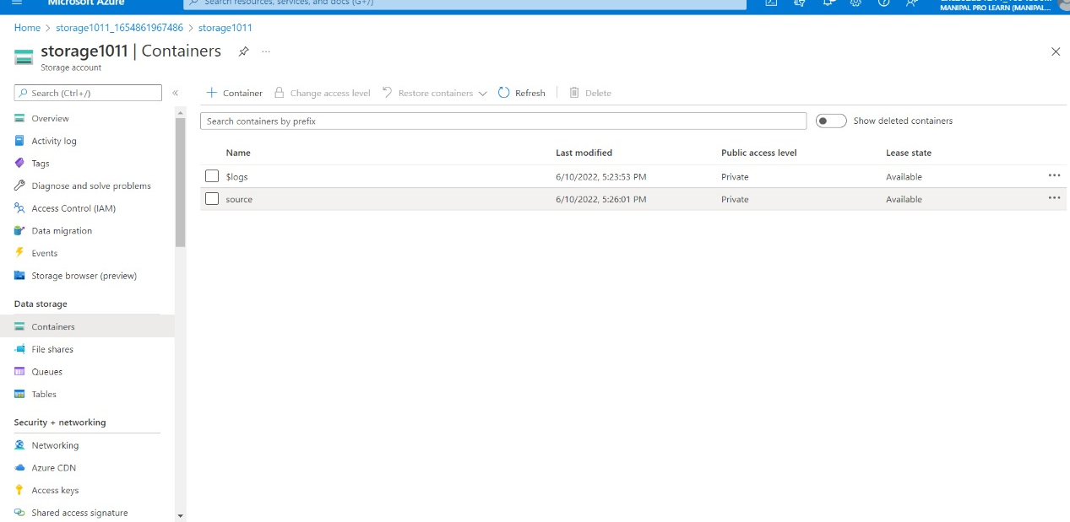

Slide 6
Step-2: Creating a SQL Database.
For creating Sql Database Search for SQl database and Create a new database.
During creation we can create SQL server also.

Slide 7
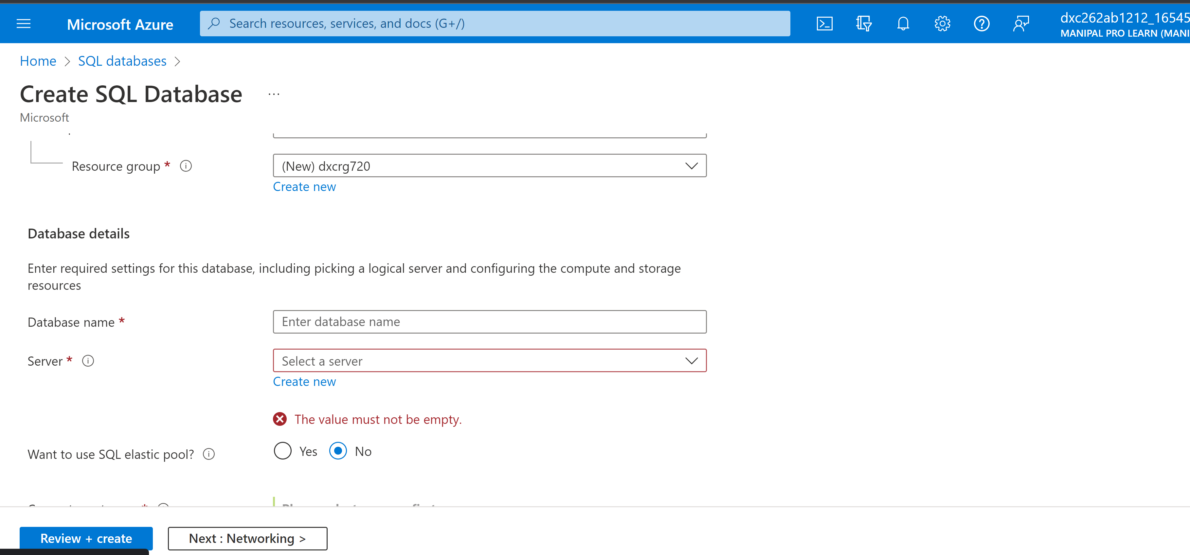
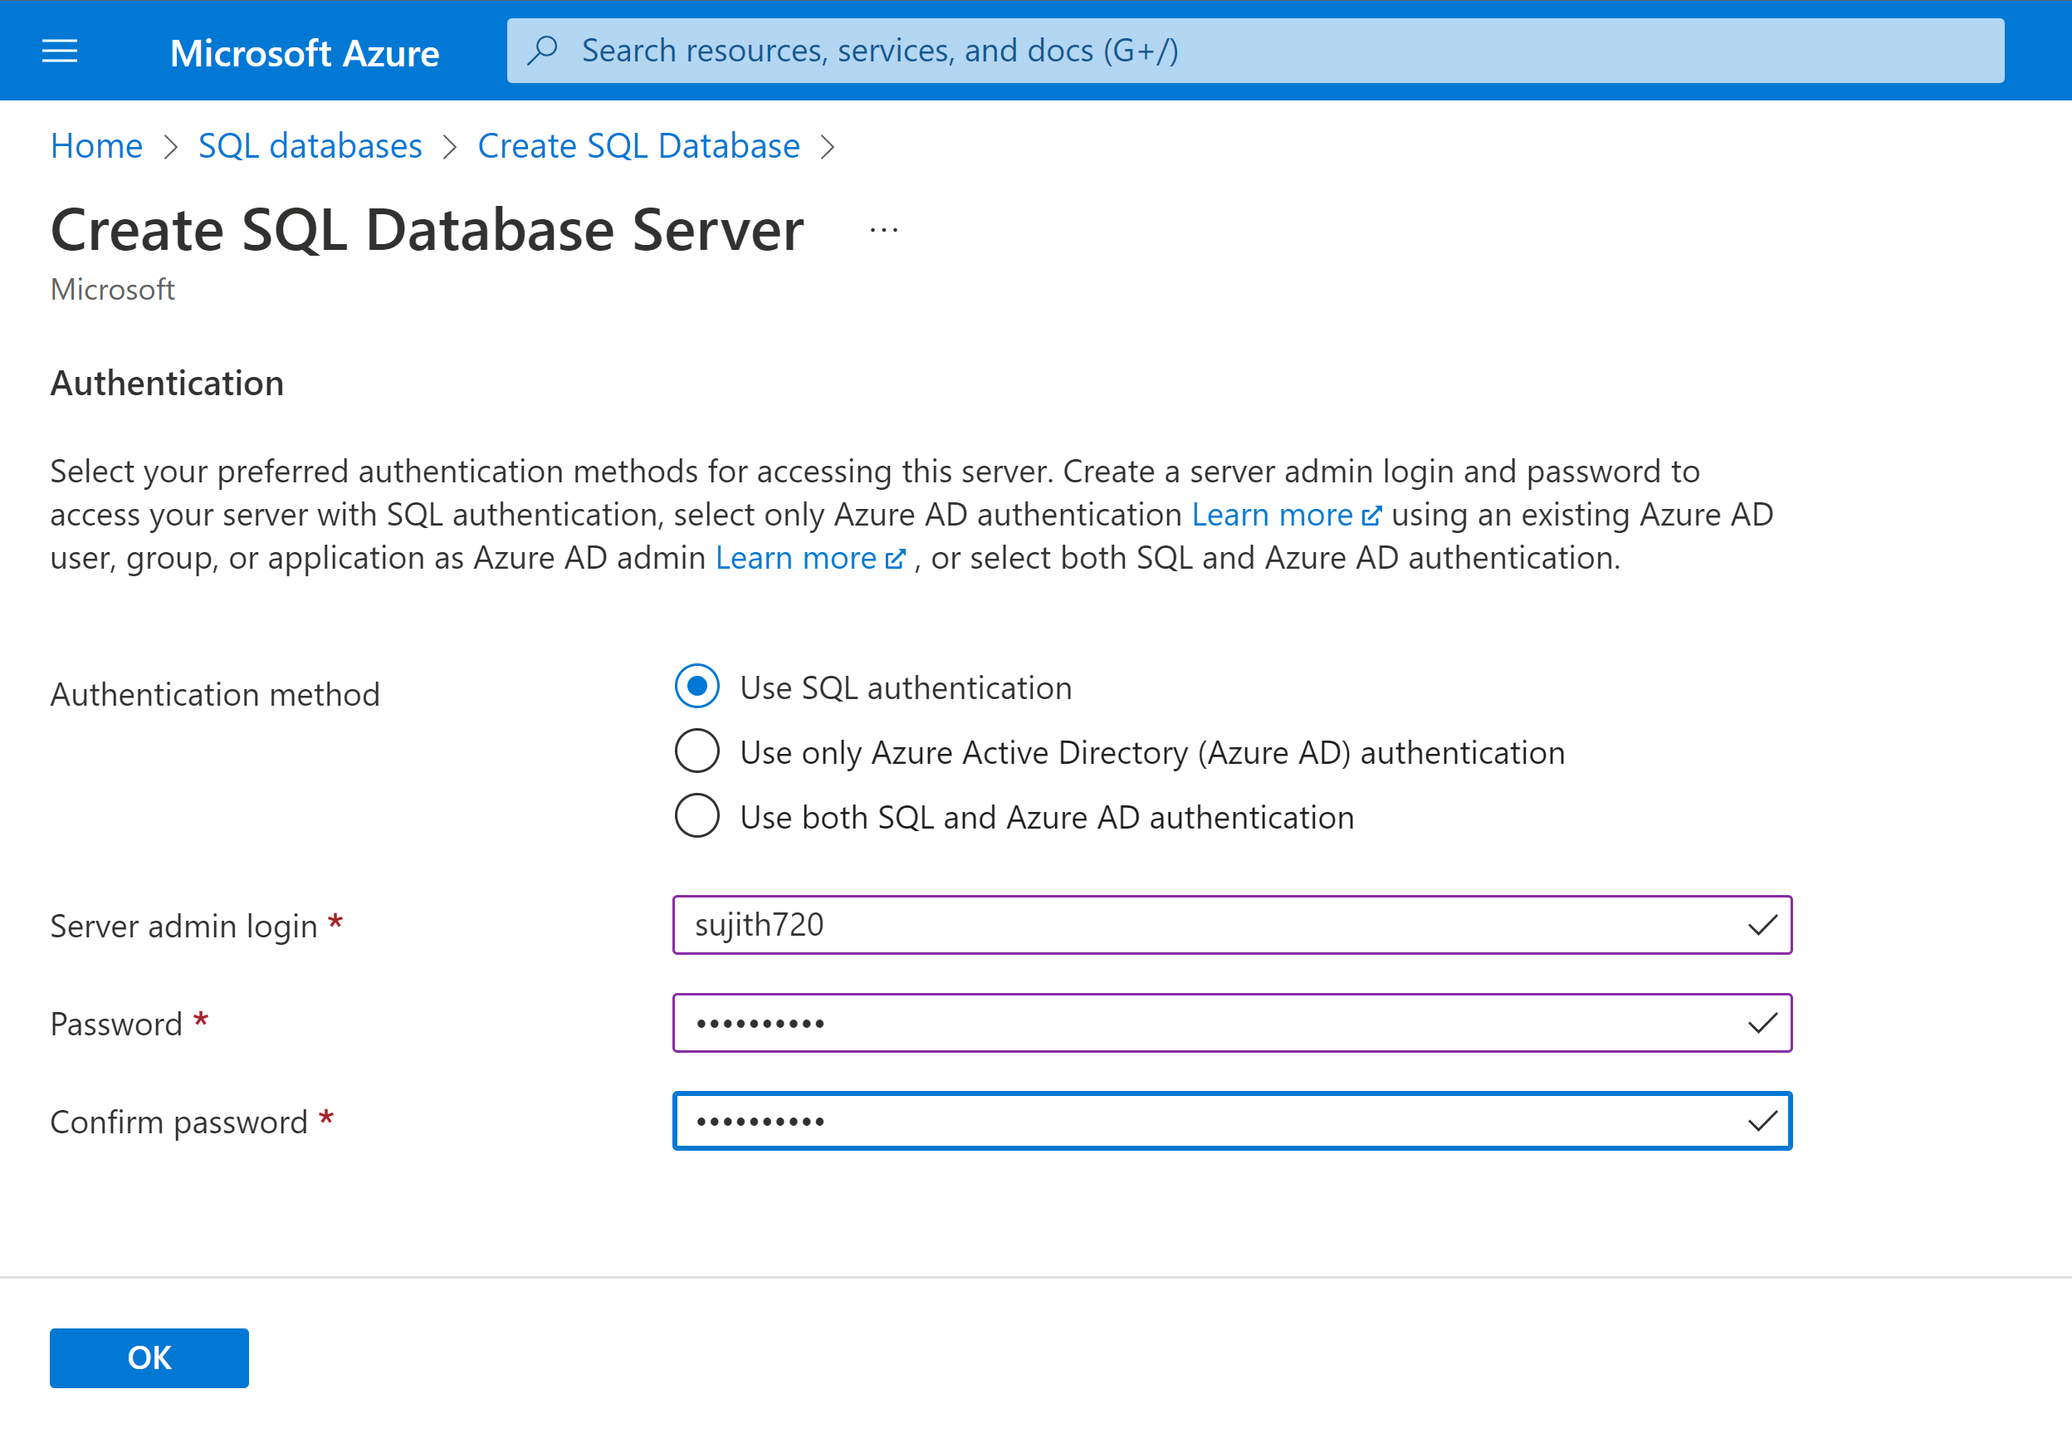

Slide 8
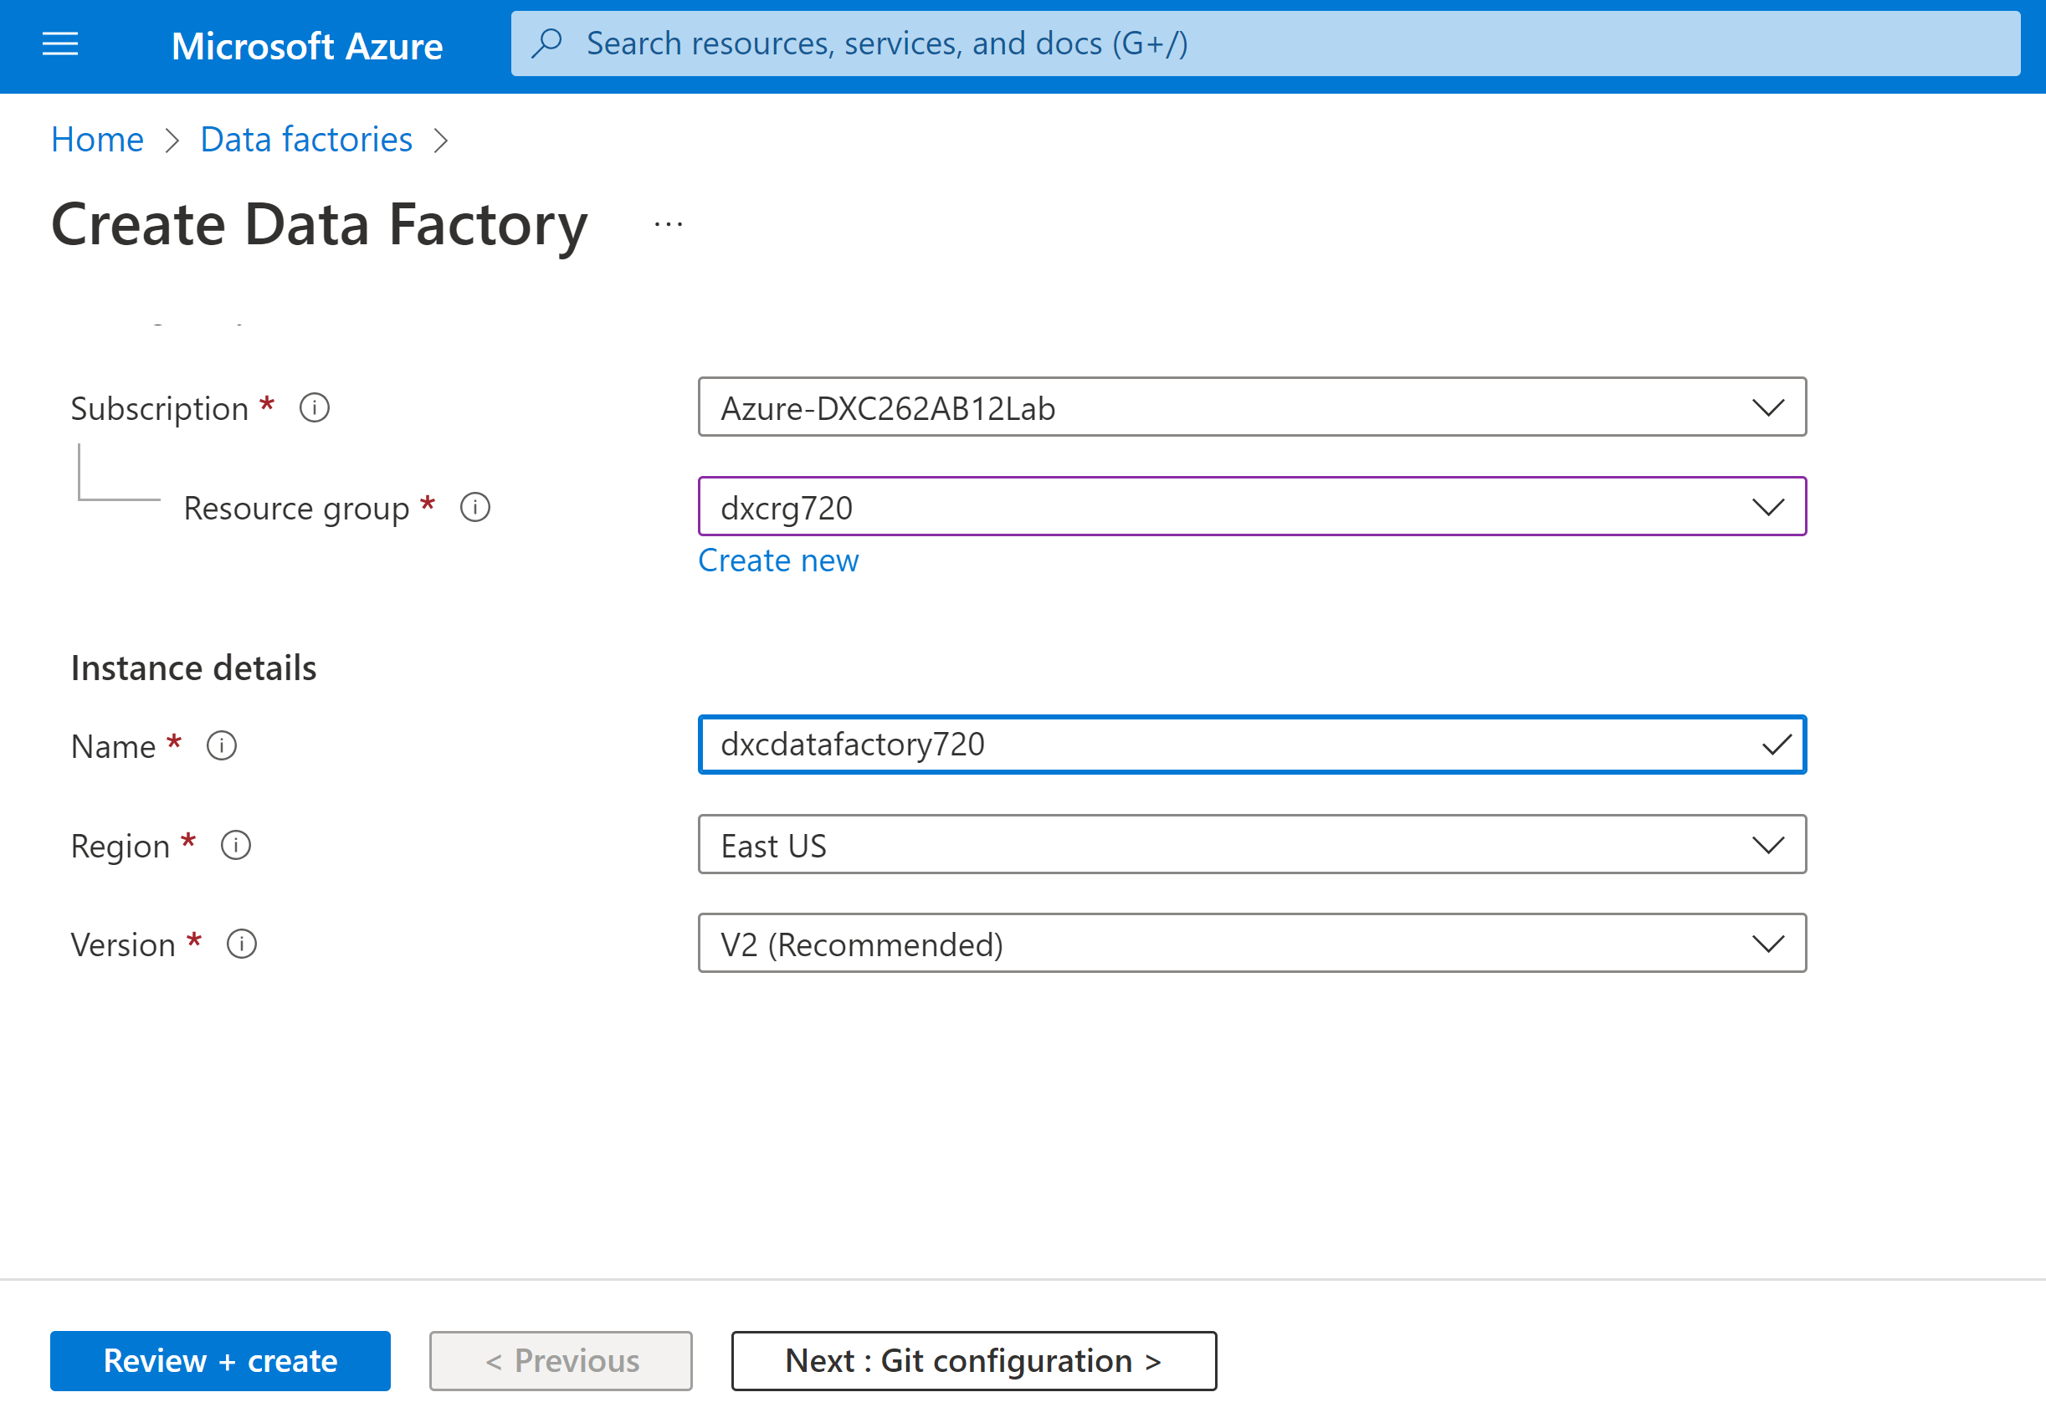
Step-3: Creating Data factories.
Search for data factories in main menu and Click on it.
Now create a new data factory.

Slide 9
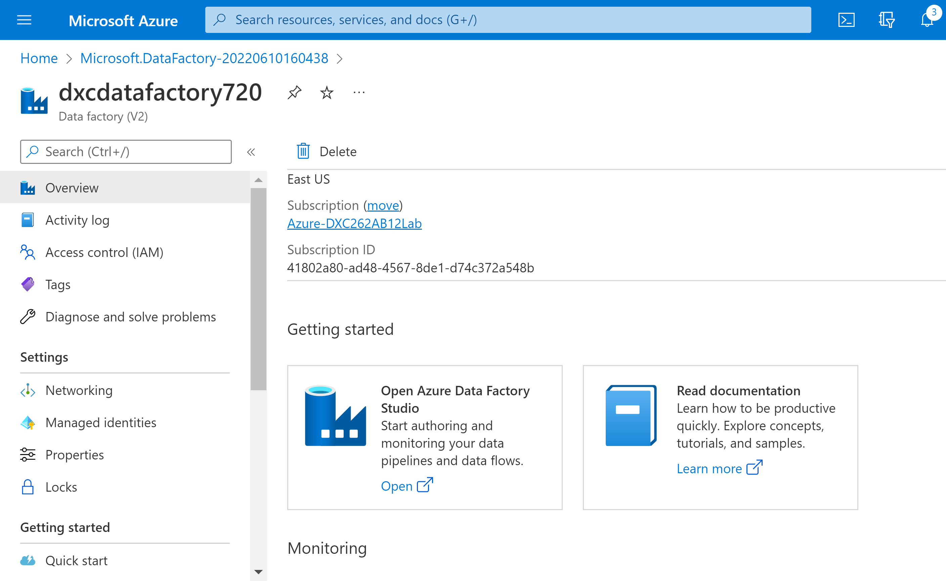
After successful creation of data factory click on resourses and open azure data factory studio.

Slide 10
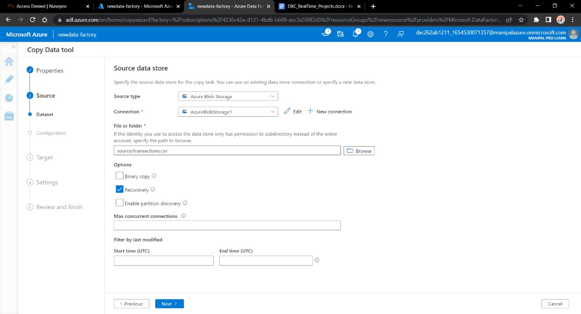
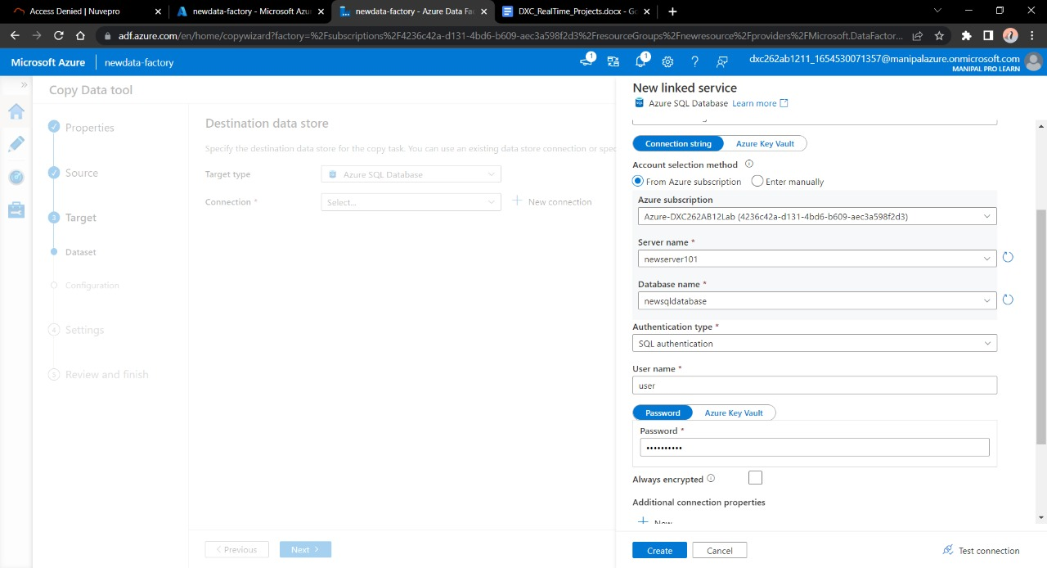
Step-4: Creating Pipeline and copying data .
At Source we will select Azure storage and at destination we will select SQL Database.
Here we going to Set a pipeline where data is copied .

Slide 11
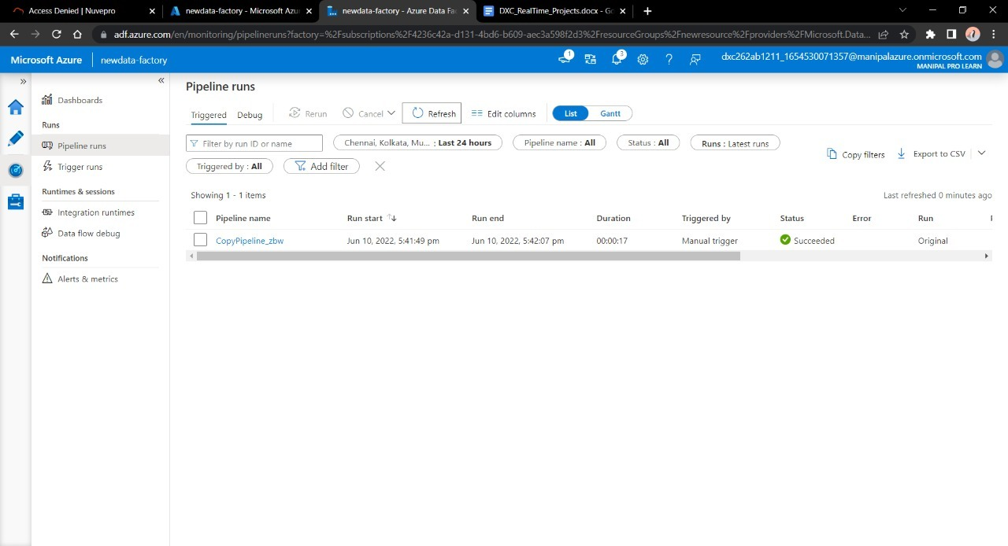
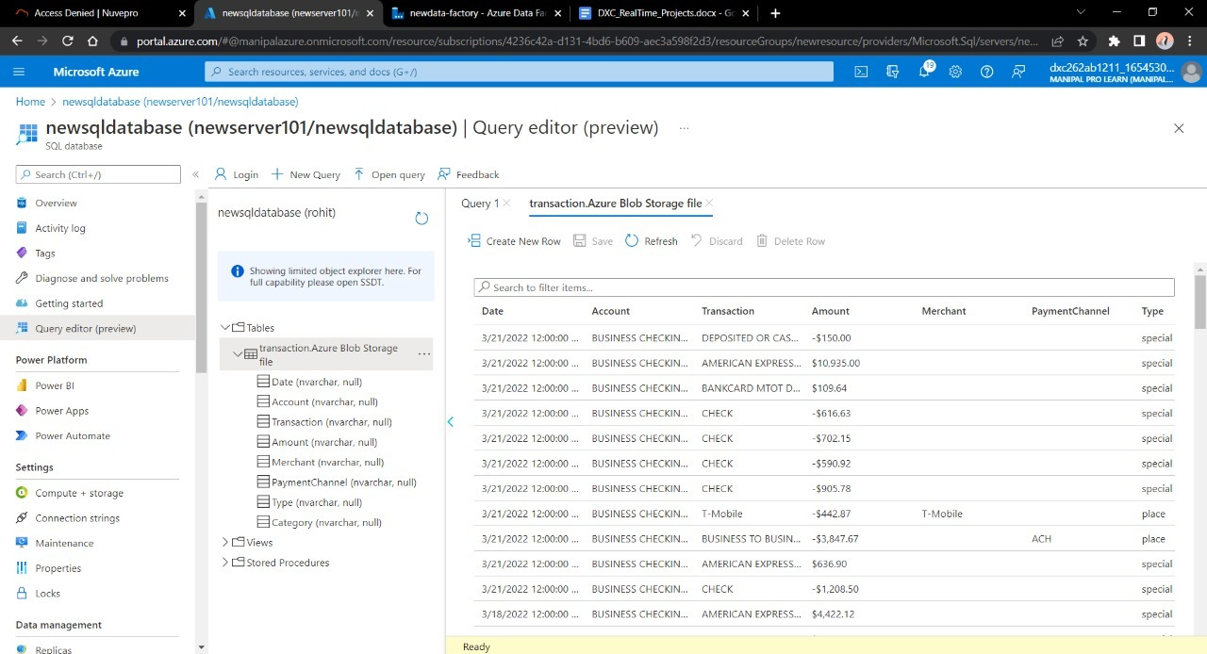

Slide 12
Project2 : AP Morgan Data Platform
TASK: Triggering Notebook of Databricks from Data factory
Steps Involved:
1. Creating databricks.
2. Creating a cluster.
3. Creating a notebook.
4. Creating datafactory and triggering .

Slide 13
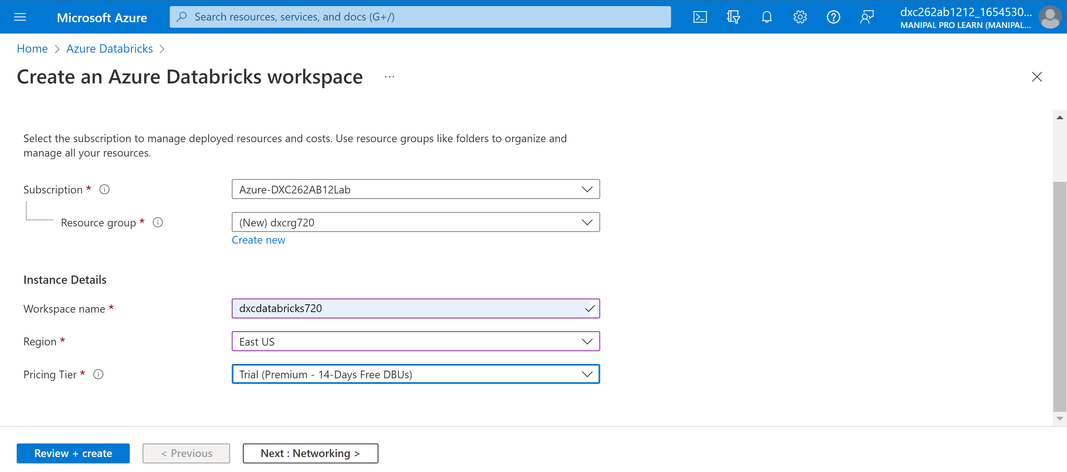
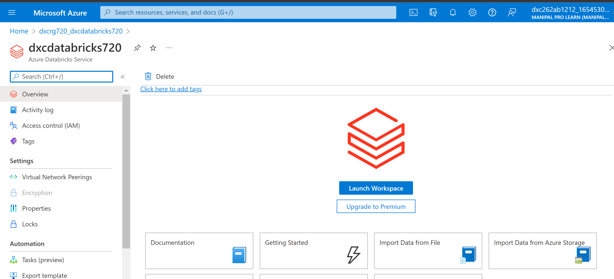
Step-1: Creating Databricks.
Search for databricks in main menu and create new databricks.
After Sucessful deployment launch databricks workspace.

Slide 14
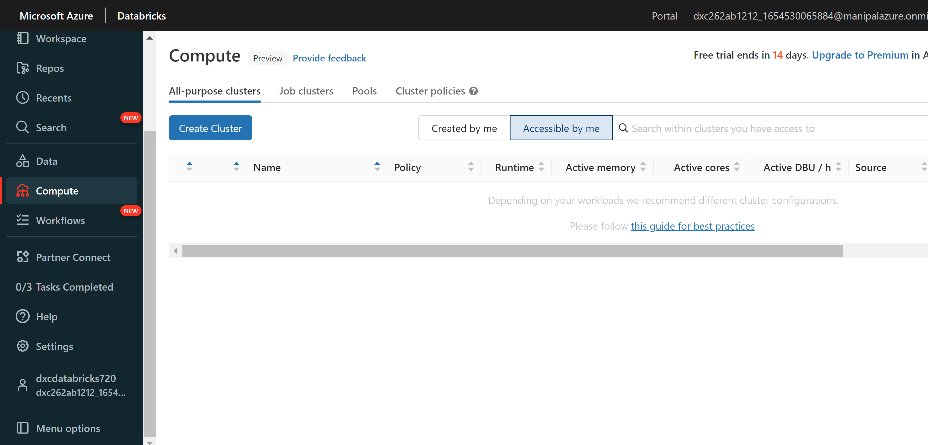
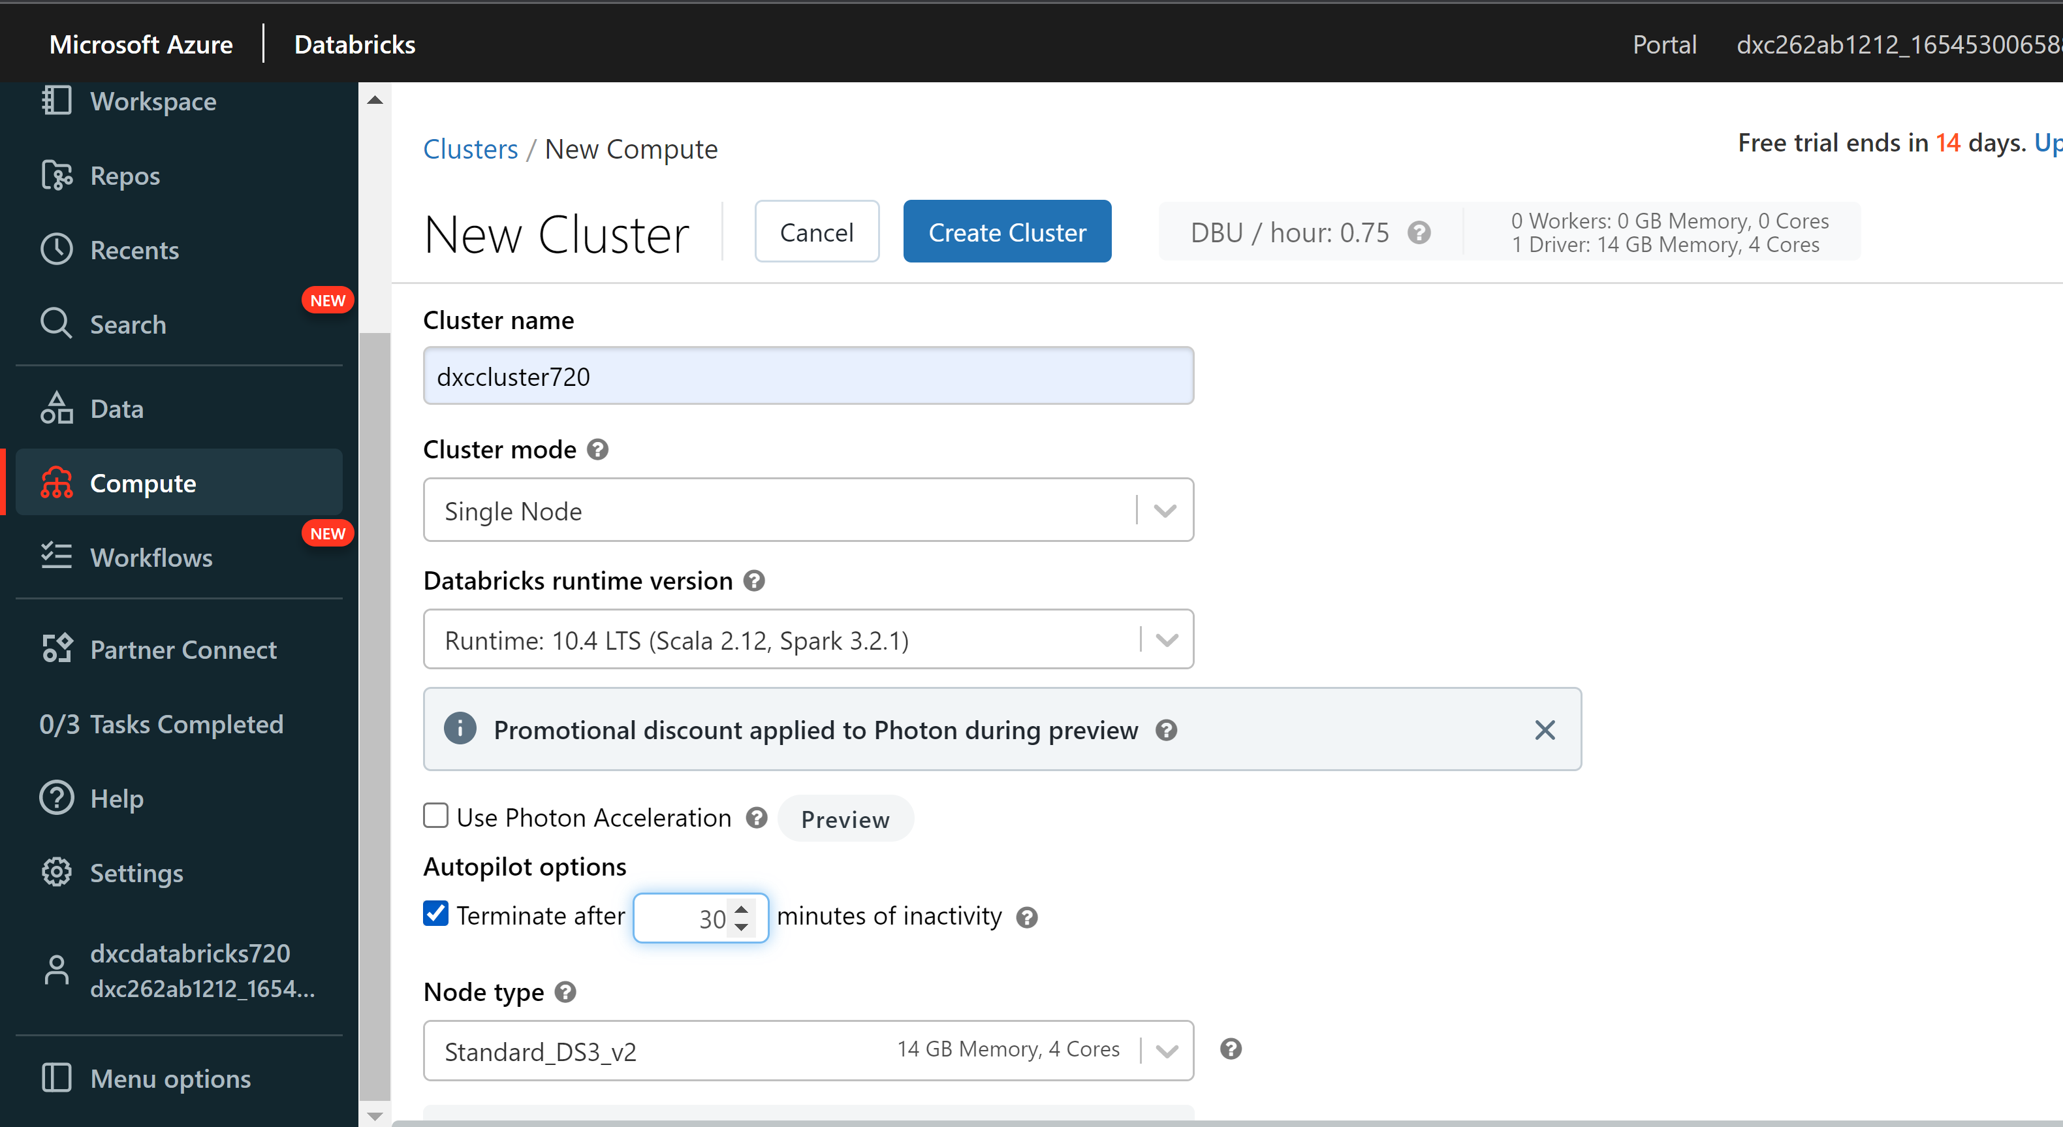
Step-2: Creating a Cluster
Goto compute to create a Newcluster.
Now fill required information and click on create cluster.

Slide 15
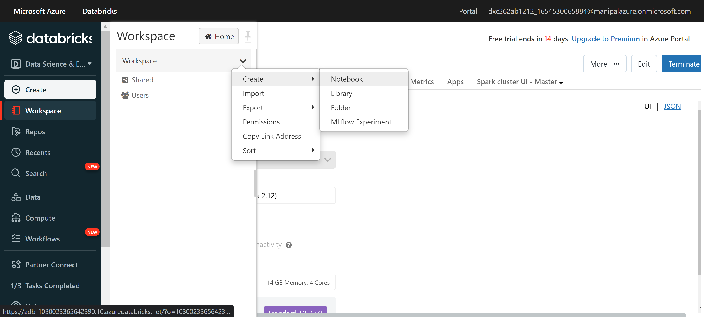
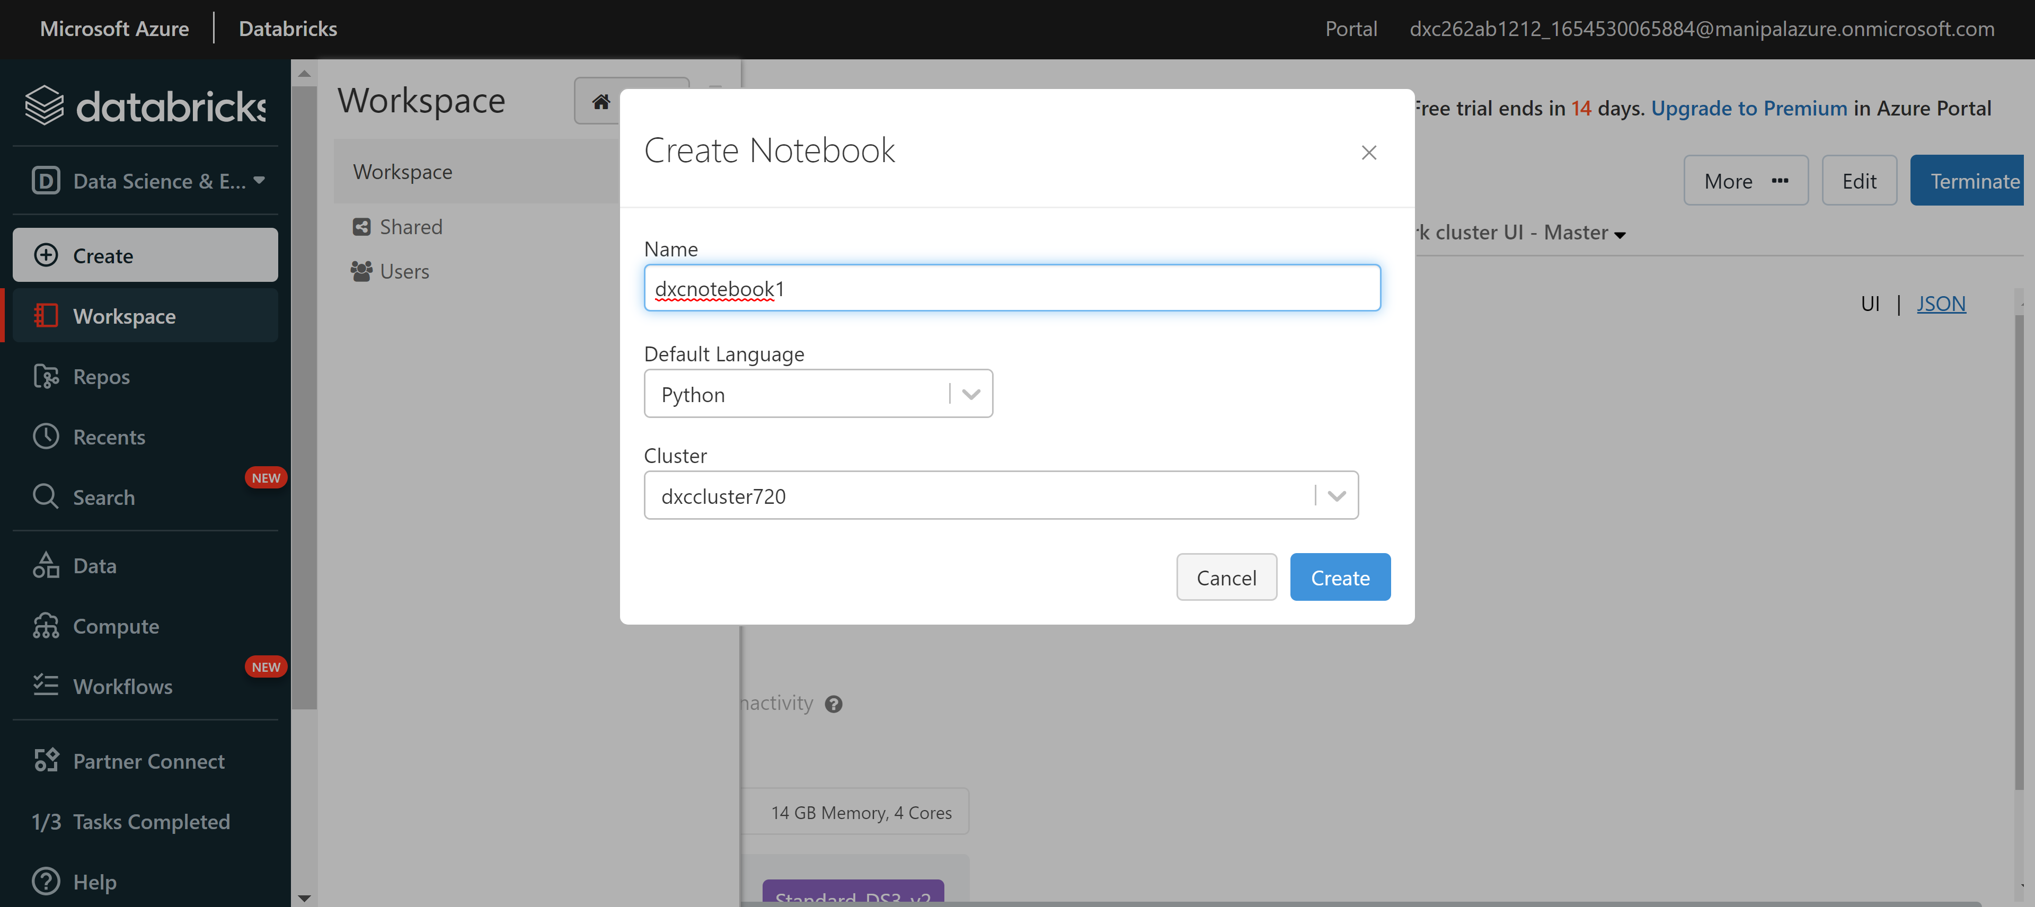
Step-3: Creating a Notebook
Goto to workspace and click on create and click on Notebook.
Give required information and click on create.

Slide 16
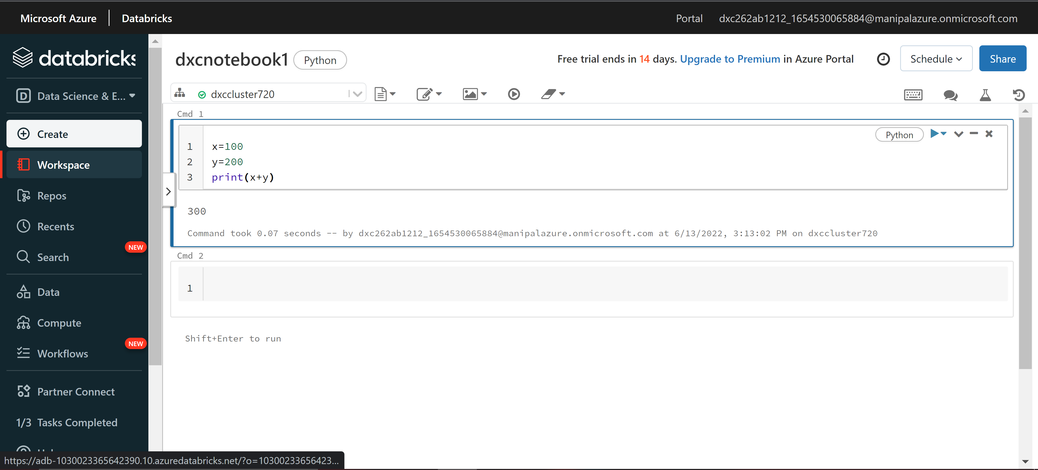
After creating notebook we can execute our code .

Slide 17
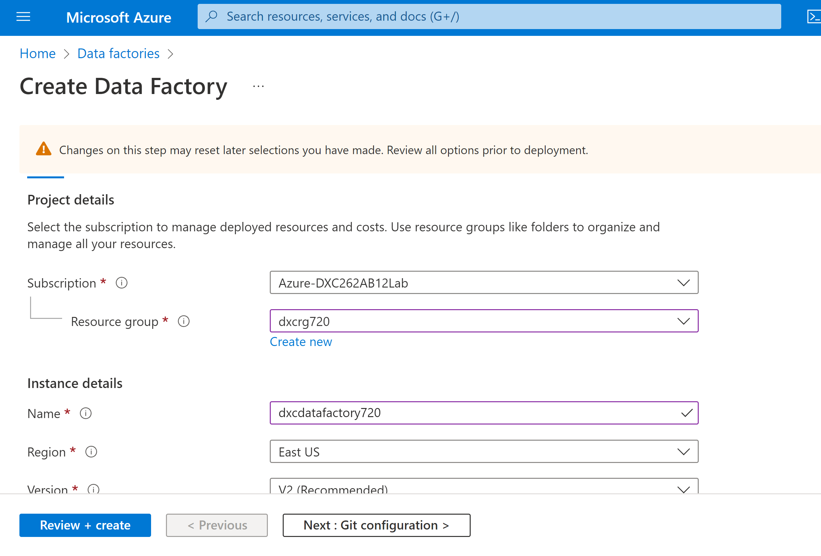
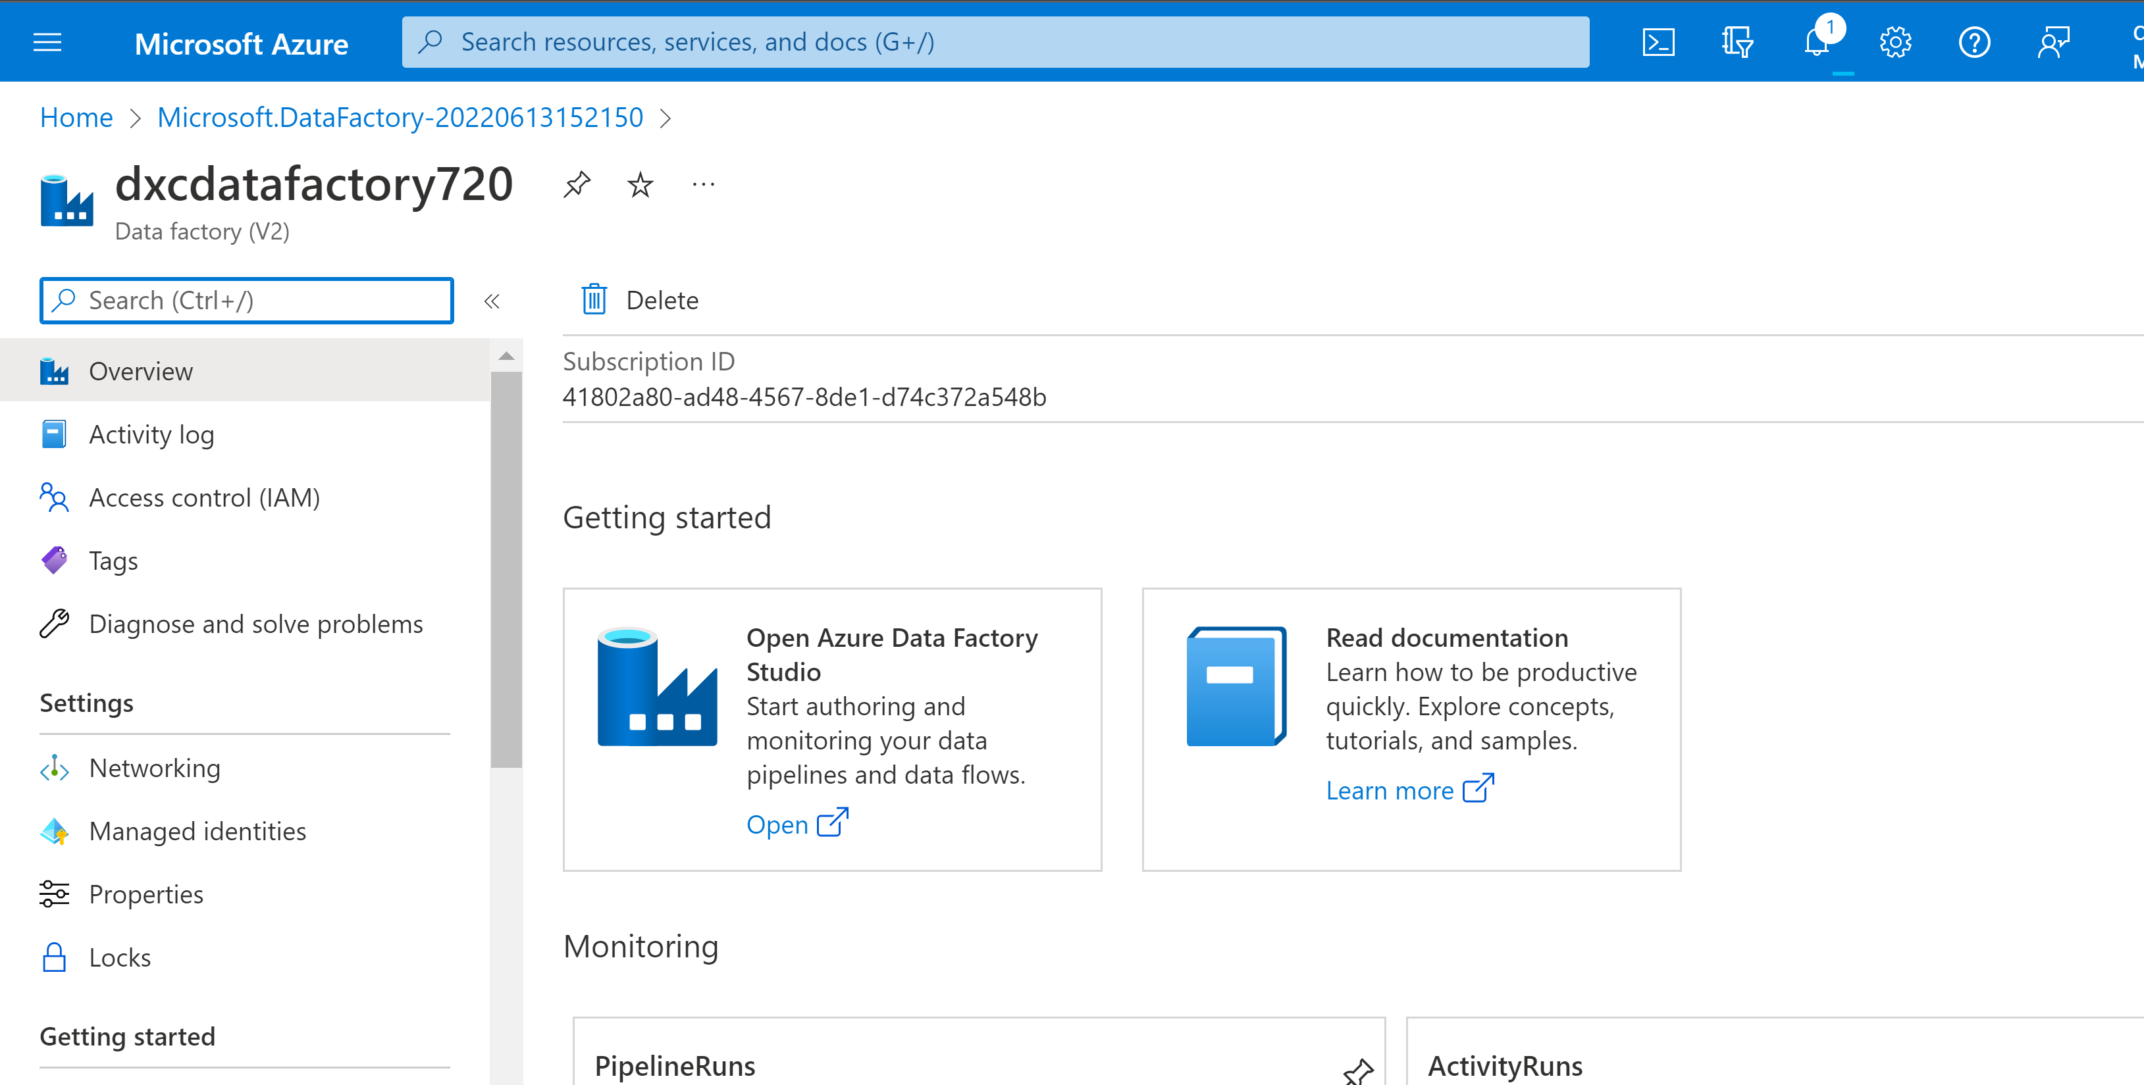
Step-4: creating Datafactory.
Search for data factories in main menu and Click on it.
Now create a new data factory and Open Azure datafactory studio.

Slide 18
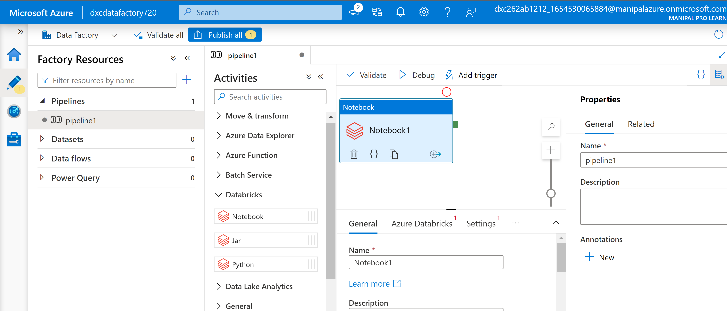
Now goto editor option and click on pipelines and create new pipeline Named pipeline1.
Under Activities of pipeline 1 select databricks dropdown abd drag &drop notebook

Slide 19
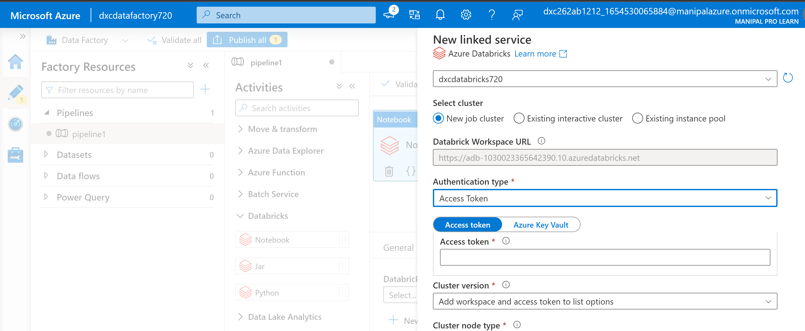
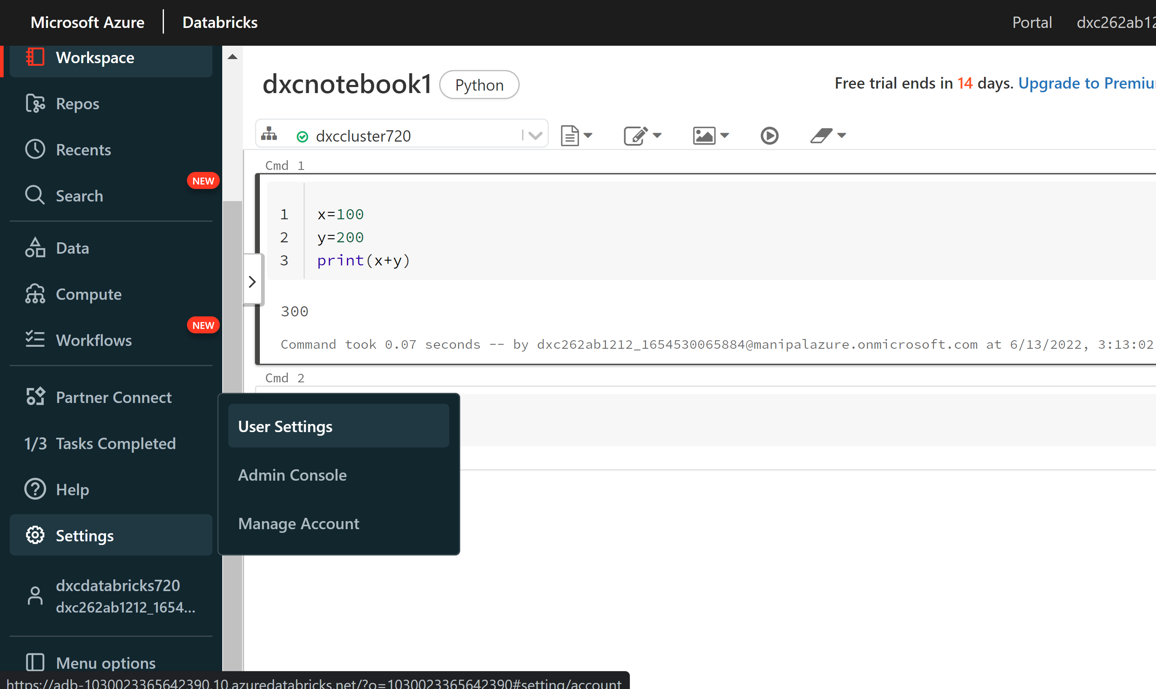
Now we need to create a linked service of databricks for this we need access token we will get from databricks.
Goto settings and user settings and click on generate token .

Slide 20
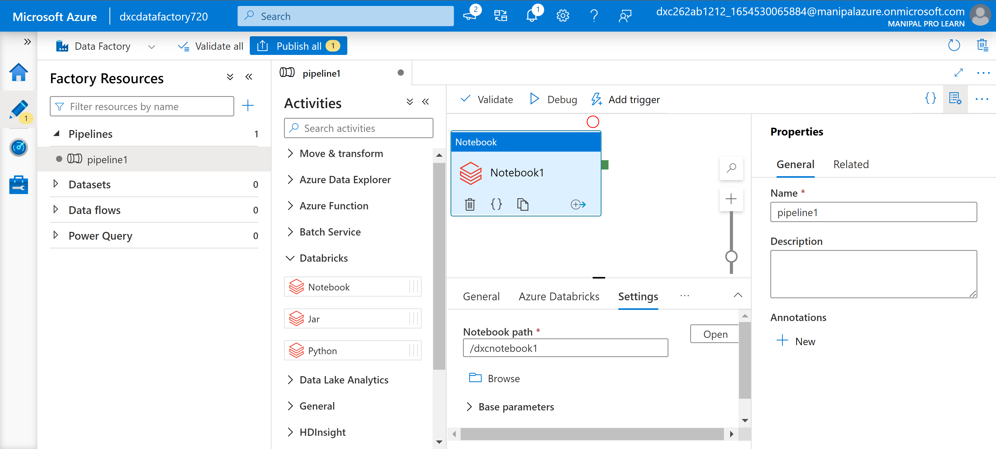
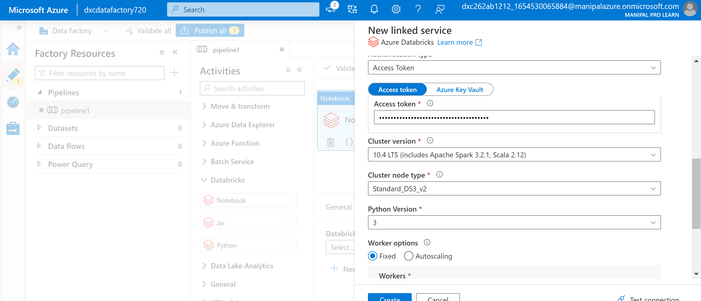
Click on create to create a link service and and define the notebook in settings and publish it.

Slide 21
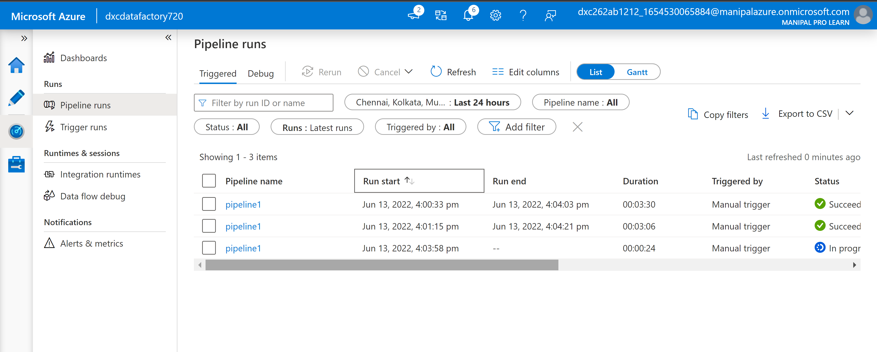
After publishing and triggering them manualing we can check it’s status by going to monitor window .
it is status is succeed .

Slide 22
THANK YOU

